Slide 1


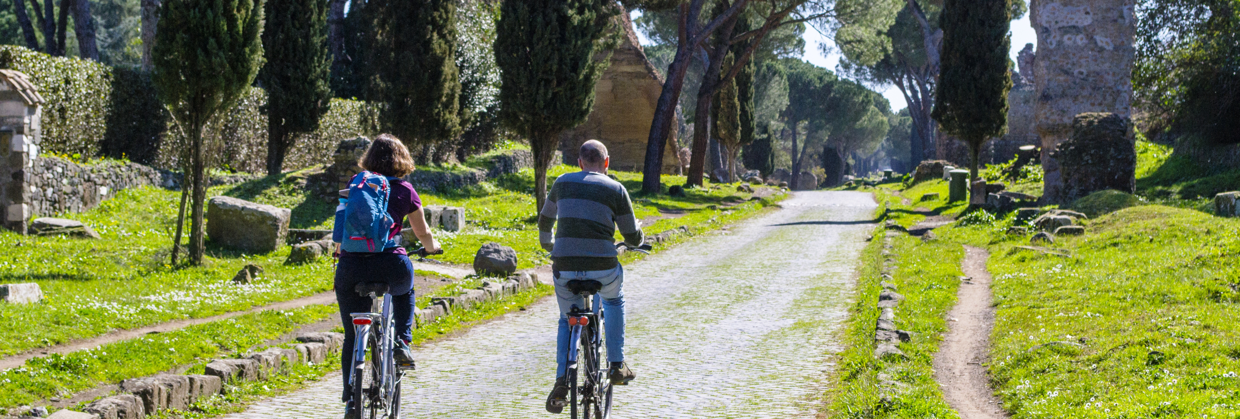









“HERItage and territory resilience through
sustainable Tourism, climate change ADAPtation
and ciTizen engagement”
HERIT ADAPT
OUR PROJECT
HERIT ADAPT is an EU co-funded project that brings together public authorities, cultural heritage managers, researchers and local stakeholders to strengthen the resilience of cultural and natural heritage through sustainable tourism and climate adaptation. The HERIT ADAPT Sustainable Tourism Model is developed and tested across diverse Euro-MED regions, including UNESCO sites and lesser-known heritage locations, and provides a methodology that can be adapted and transferred to new areas.
Total budget
Project duration
Interreg Funds
€ 3.798.740,00
51 months
€ 3.038.991,97
PROJECT PARTNERS
Region of Western Greece • Industrial Systems Institute, ATHENA Research Centre • European Public Law Organization • Sapienza University of Rome • Municipality of Genoa • Dubrovnik Development Agency • Limassol Tourism Development and Promotion Co Ltd • Old Royal Capital Cetinje • University of Granada • Ministry of Tourism of the Republic of Bulgaria • Sud de France Development • Andalusian Regional Ministry of Tourism and Andalucia Exterior • IrRADIARE • Saranda Municipality • Municipality of Ohrid • Museums and Monuments of Portugal P.B.E
Visit our website: https://heritadapt.interreg-euro-med.eu
Follow us in our social media

